Slide 1


Creating Real-Time Dashboards with Kibana
Special Topics in Software Engineering
Ștefan Cristian
Group 1272E

Slide 2
What Are Real-Time Dashboards?
Dashboards that automatically update when new data arrives
Used to monitor systems, websites, sensors, security events, etc.
Powered by streaming data from logs, APIs, or event pipelines

Slide 3
Why Real-Time Dashboards Matter
Detect problems quickly (errors, attacks, spikes)
Improve decision-making
Understand user behavior in real time
Critical in industries like e-commerce, healthcare, security
Eg:
  Netflix uses real-time dashboards for video streaming performance (source: Netflix Tech Blog).
  Hospitals use real-time dashboards to monitor ICU vitals.

Slide 4
What Is Elasticsearch?
A distributed, NoSQL search and analytics engine
Optimized for high-volume logs and time-series data
Part of the Elastic Stack (ELK Stack): Elasticsearch → Logstash → Kibana

Slide 5
What Is Kibana?
A visualization and dashboard tool
Works on top of Elasticsearch
Used for:
  Log analysis
  Security monitoring
  Business dashboards
  Website analytics

Slide 6
Real-World Uses of Kibana
Airbnb: monitoring service health
Uber: rides data and surge pricing monitoring
Banking: fraud detection and alert dashboards
Healthcare: real-time patient data dashboards
E-commerce: website visitors, sales, and errors

Slide 7
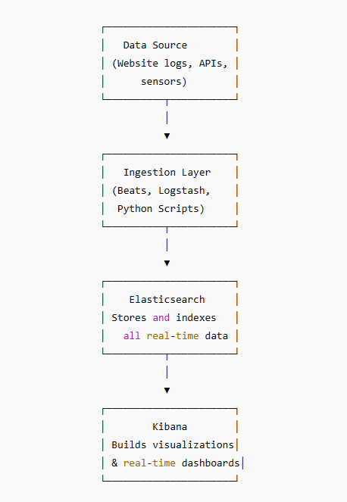
Architecture of a Real-Time Dashboard
Eg: Website visits → sent to Elasticsearch → Kibana updates dashboard every second

Slide 8
How Kibana Dashboards Work
Connect to an Elasticsearch index
Visualize data using:
  Line charts
  Bar charts
  Maps
  Pie charts
  Tables
Combine multiple visualizations into one dashboard
Enable auto-refresh (e.g., every 5 seconds)

Slide 9
Demonstration Scenario
Goal: Show how a Kibana dashboard is created and updated in real time.
We will demonstrate:
  Where to get data
  How to load data into Kibana
  How to create visualizations
  How to build a real-time dashboard
  How to turn on auto-refresh
  Below I will put the code and snips about how I created a Kibana dashboard and the result.
  It was not included in the PPT because I was planning for a live demo.

Slide 10
Code
I used a python program to generate data to be visualized by Kibana.
import random
import time
import requests
from datetime import datetime
ELASTIC_URL = "https://my-elasticsearch-project-cfbc16.es.us-central1.gcp.elastic.cloud:443"
API_KEY = "T3NDcEdac0I5ZURwWnFvd1FELWQ6RjZXT3h2WlBNenk3ZEVNaFdrSTFNdw=="
INDEX_NAME = "ecommerce-sales"
headers = {
"Authorization": f"ApiKey {API_KEY}",
"Content-Type": "application/json"
}

Slide 11
product_catalog = [
{"name": "Laptop", "category": "Electronics", "price": 4500},
{"name": "Smartphone", "category": "Electronics", "price": 2800},
{"name": "Headphones", "category": "Electronics", "price": 450},
{"name": "T-shirt", "category": "Clothing", "price": 120},
{"name": "Jeans", "category": "Clothing", "price": 250},
{"name": "Sneakers", "category": "Clothing", "price": 480},
{"name": "Coffee Machine", "category": "Home Appliances", "price": 900},
{"name": "Vacuum Cleaner", "category": "Home Appliances", "price": 1100},
{"name": "Book", "category": "Books", "price": 80},
{"name": "Backpack", "category": "Accessories", "price": 200},
]
countries = ["Romania", "Germany", "France", "UK", "Italy"]
cities = ["Bucharest", "Berlin", "Paris", "London", "Rome"]
payment_methods = ["Card", "Cash on Delivery", "PayPal"]
order_statuses = ["Completed", "Pending", "Cancelled"]

Slide 12
def generate_sale():
product = random.choice(product_catalog)
quantity = random.randint(1, 4)
total_price = product["price"] * quantity
return {
"timestamp": datetime.utcnow().isoformat(),
"order_id": random.randint(100000, 999999),
"product_name": product["name"],
"category": product["category"],
"unit_price": product["price"],
"quantity": quantity,
"total_price": total_price,
"payment_method": random.choice(payment_methods),
"order_status": random.choices(
order_statuses, weights=[0.8, 0.15, 0.05]
)[0],
"buyer": {
"buyer_id": random.randint(1, 1000),
"age": random.randint(18, 70),
"country": random.choice(countries),
"city": random.choice(cities),
},
"delivery_address": {
"street": f"Street {random.randint(1, 100)}",
"city": random.choice(cities),
"country": random.choice(countries),
"postal_code": f"{random.randint(10000,99999)}"
}
}

Slide 13
while True:
sale = generate_sale()
response = requests.post(
f"{ELASTIC_URL}/{INDEX_NAME}/_doc",
headers=headers,
json=sale
)
print("Sent sale:", sale)
time.sleep(3)

Slide 14
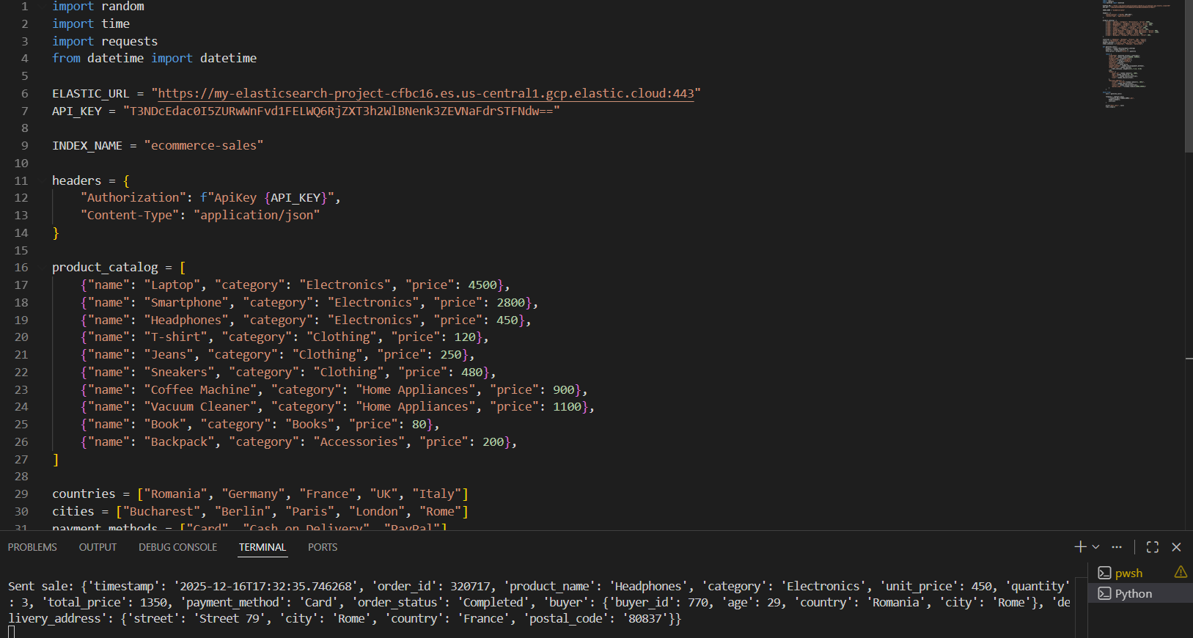

Slide 15
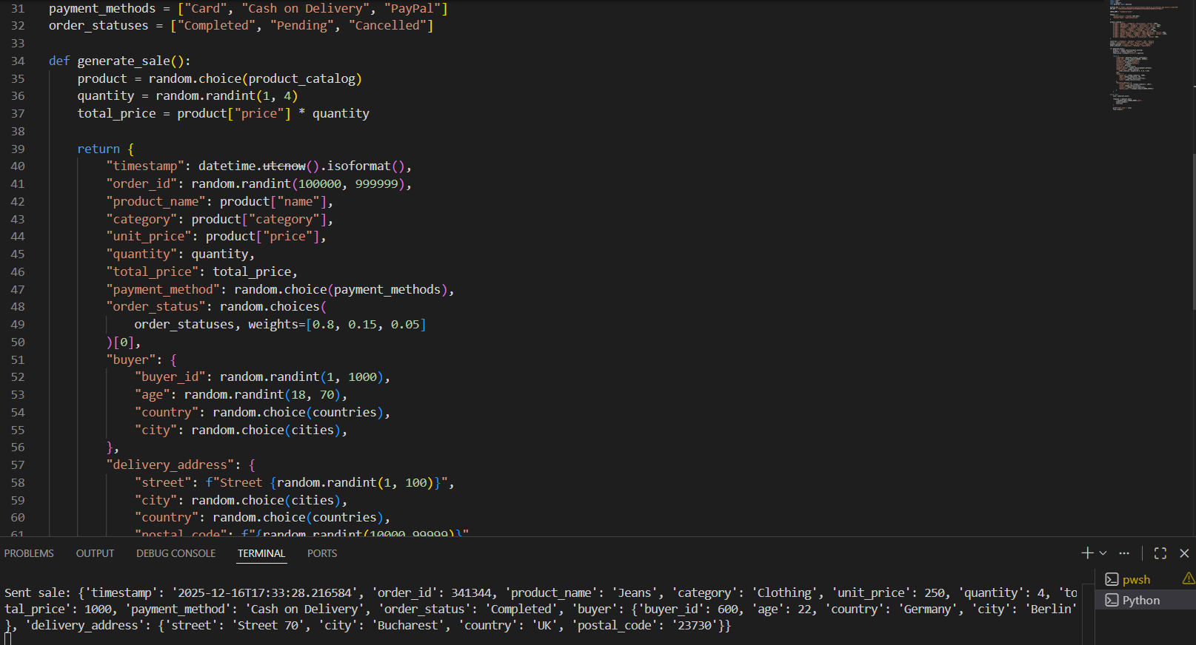

Slide 16
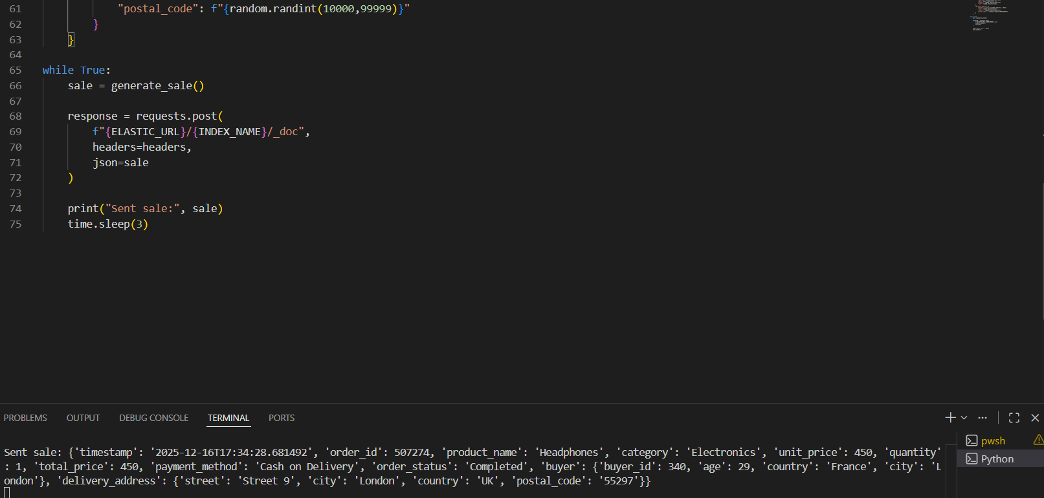

Slide 17
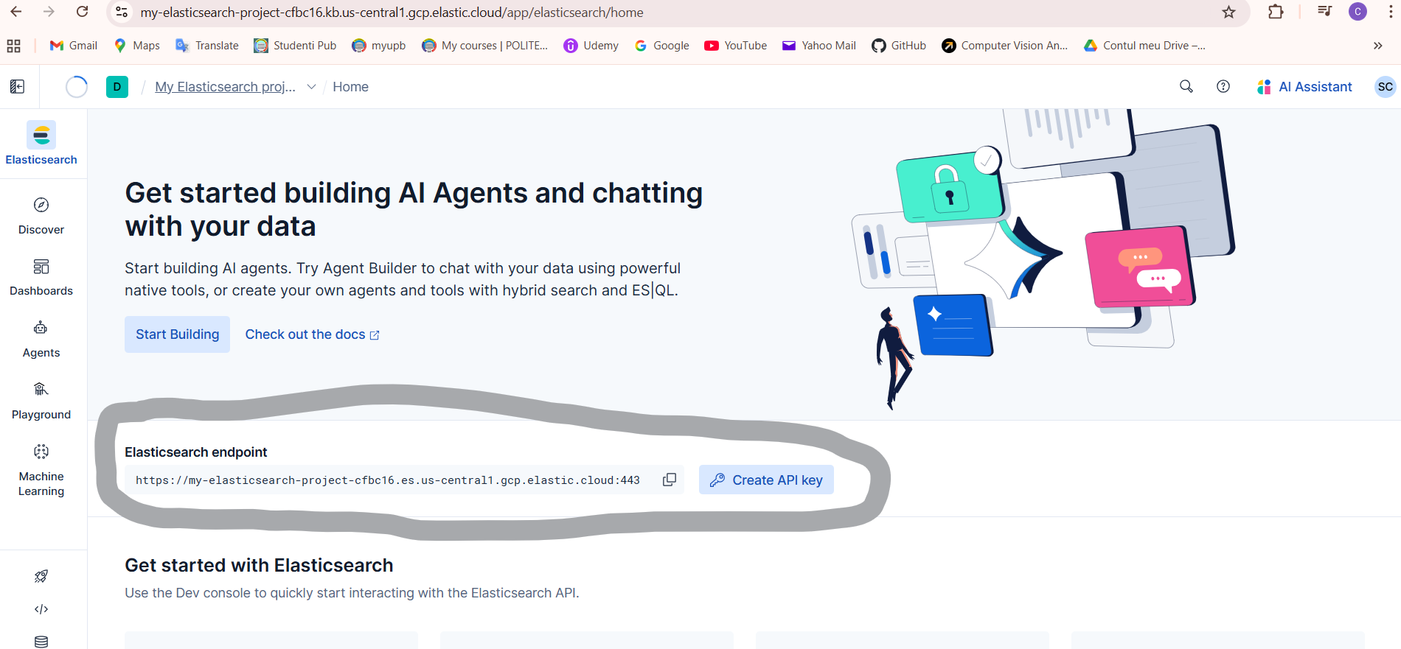
From here I took the endpoint and the API key for the python code implementation with Elastic in order to be able to link it with Kibana later.

Slide 18
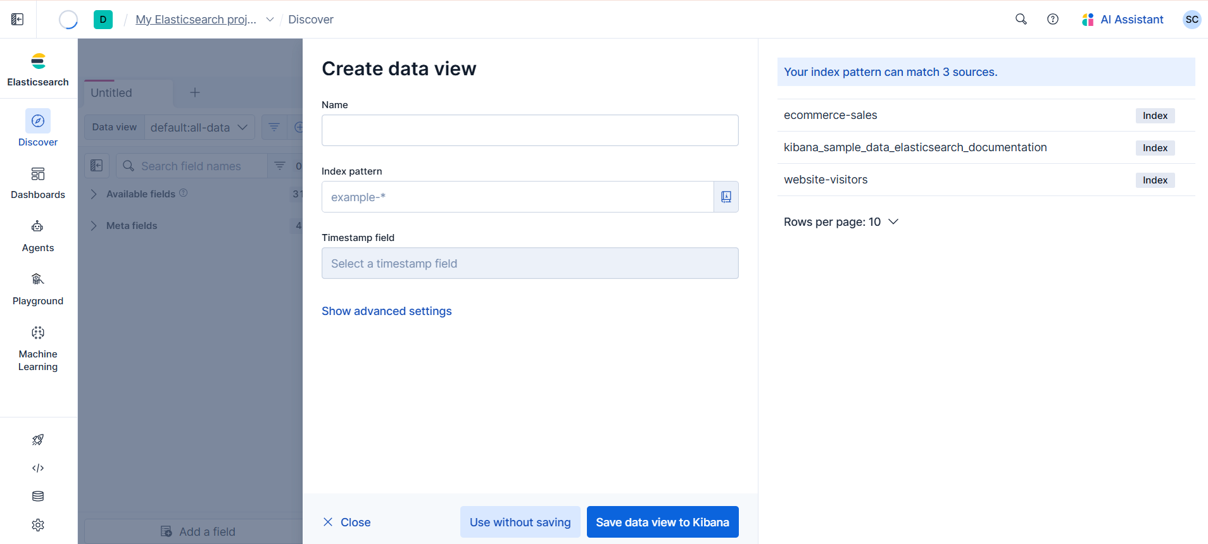
Here I created the necessary dataview for the Dashboard. This way I finished linking Kibana with my data from the python program.

Slide 19
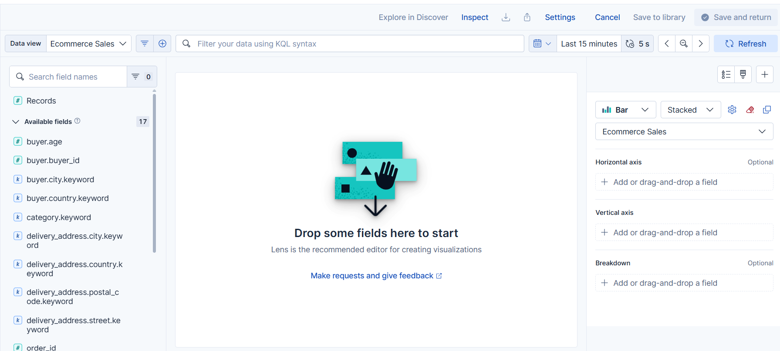
After clicking: Dashboards -> Create Dashboard -> Create Visualization I get to the below page where I add visualizations to populate the dashboard

Slide 20
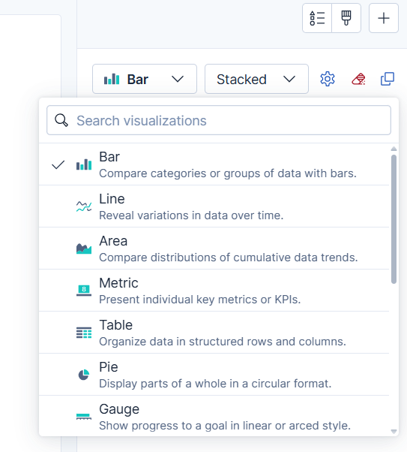
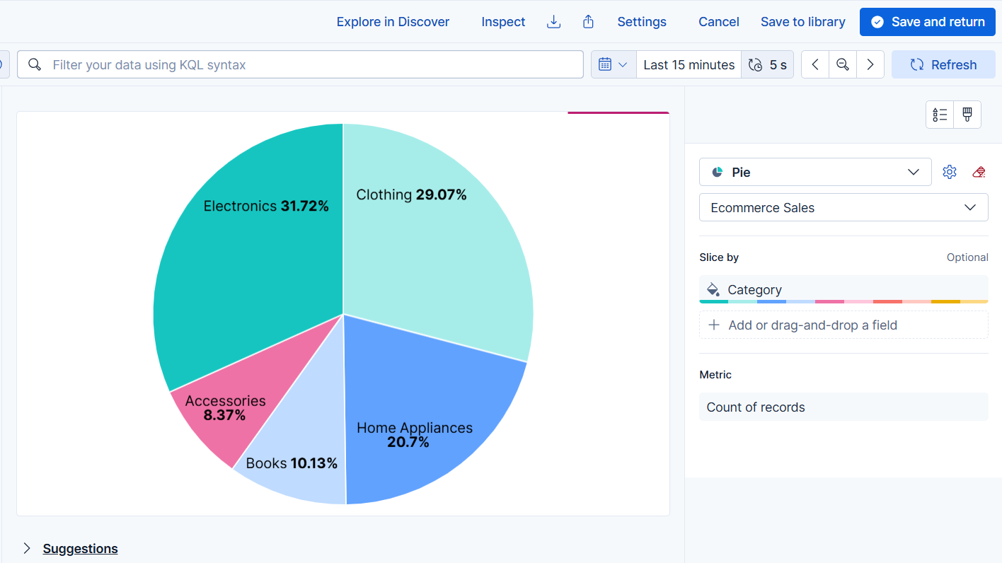
From this cascade menu we can select certain visualisations and to create them like the simple pie chart you see in the second image. After pressing Save and return the visualization will be saved in the dashboard and so we can populate it with multiple visualizations.

Slide 21
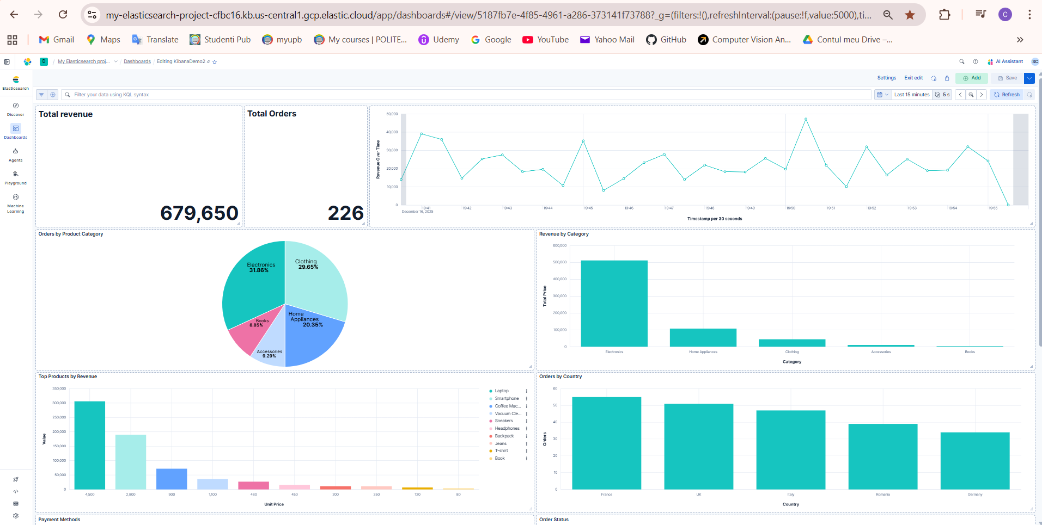
After populating the dashboard with different types of visualizations and setting the refresh to 5 seconds it looks like this

Slide 22
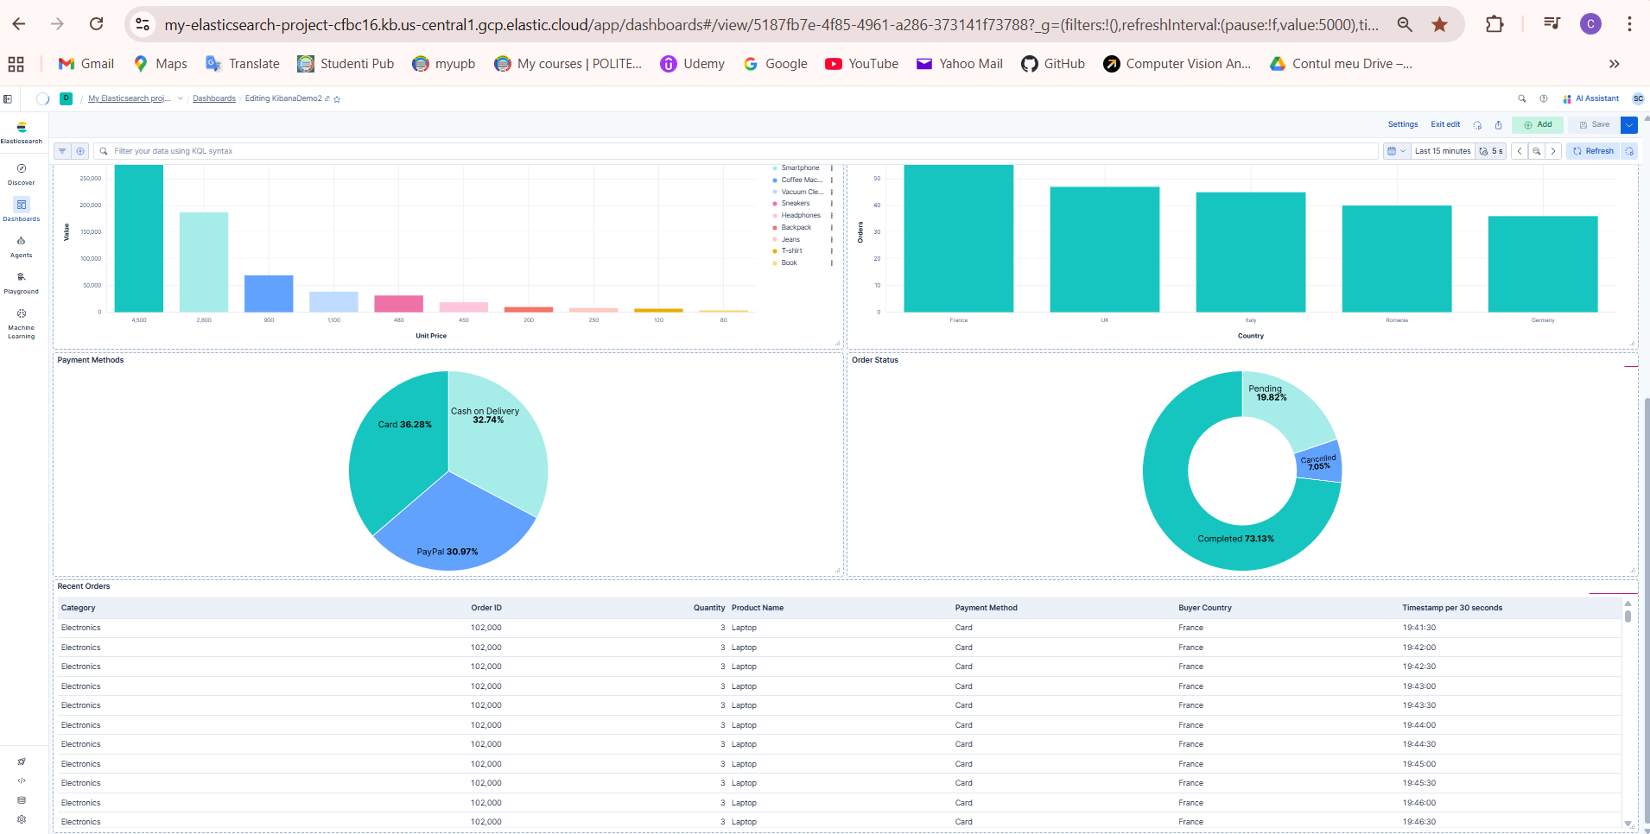

Slide 23
Thank you!

